Slide 1
WARNING
These slides are not optimized for printing or exam preparation. These are for lecture delivery only.
These slides are made for PowerPoint 2010/2013. They may not show up well on other PowerPoint versions. You can download PowerPoint 2010 viewer from here.
These slides contain a lot of animations. For optimal results, watch in slideshow mode.

Slide 2

Testing: Introduction

Slide 3

Test case
ID: TC04
Description: …
other test cases
test input
expected output
Compare
mismatch $⇒$ test failure
could be due to a defect
Software Under Test (SUT)
actual output
SUT
Test case
Test failure
Basic terminology

Slide 5

Bug fix → break other code?
REGRESSIONS
[undesirable side effects of modifications]

Slide 6
Test case N
ID: TC04
Description: …
other test cases
test input
expected output
Regression testing
Compare
Mismatch!
Software Under Test (SUT)
actual output
Locate bug
modify
REGRESSION
bug located!

Slide 7
Test case N
ID: TC04
Description: …
other test cases
test input
expected output
Regression testing
Compare
Mismatch!
Software Under Test (SUT)
actual output
Locate bug
modify
… is the re-running of existing tests to detect regressions.
bug located!

Slide 8
Test case N
ID: TC04
Description: …
other test cases
test input
expected output
Regression testing
Compare
Mismatch!
Software Under Test (SUT)
actual output
Locate bug
modify
For this to work:
1. Document test cases
2. Automate testing
bug located!

Slide 10
Automated testing of CLI applications

Slide 11
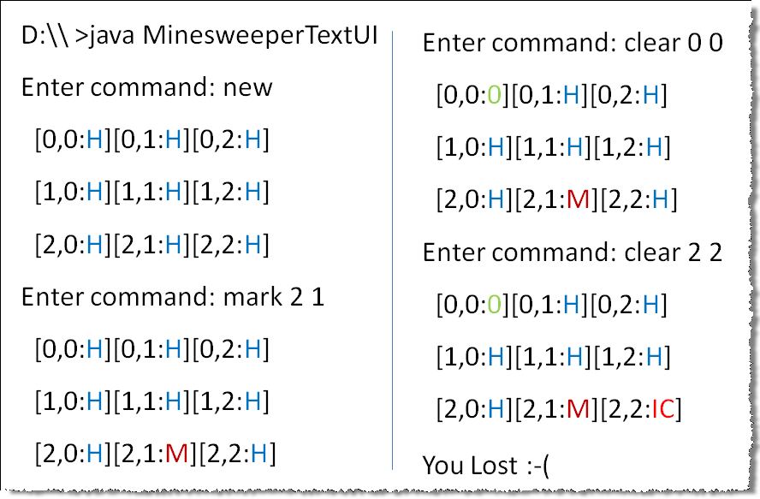
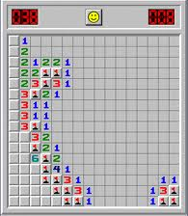
Example SUT (Text UI Minesweeper)

Slide 12
Example SUT (Text UI Minesweeper)

Slide 13
Example SUT (Text UI Minesweeper)

Slide 14
Example SUT (Text UI Minesweeper)

Slide 15
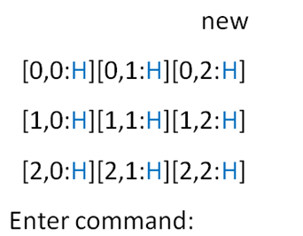
1. Document test cases
Testing
Test case 1:
input:
expected:
Test case 2:
input:

Slide 16
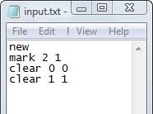
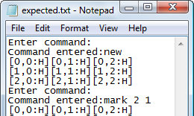
2. Automate testing (for Text UIs)
TEST CASE 1
test input
expected output
TEST CASE 2
test input
expected output
TEST CASE 3
test input
expected output

Slide 17

2. Automate testing (for Text UIs)
TEST CASE 1
test input
expected output
TEST CASE 2
test input
expected output
TEST CASE 3
test input
expected output

Slide 18
2. Automate testing (for Text UIs)
test input
expected output
test input
expected output
test input
expected output

Slide 19
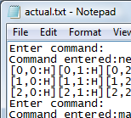
2. Automate testing (for Text UIs)
I/O redirection
C:\java MinesweeperTextUI
FC actual.txt expected.txt
Comparing files actual.txt and expected.txt
FC: no differences encountered
<input.txt >actual.txt
C:\

Slide 20
Automated testing of CLI applications – Why?
Check if the behavior changed
Was the change intended?
Yes: update the test case
No: find and fix bugs

Slide 21


